Slide 1

Bootcamp Final Project
Loan Prediction
Team #6
Michael Okoro
Ravish Sikha
Jeremy Wagerik

Slide 2

Topic and Description of Data
Project Focus: Predicting whether a new loan applicant defaults on their loan Goal: Create Supervised Machine Learning Model Train on Loan Status based on the applicant’s data Predict new applicant’s loan approval
Data Source: Lending Club’s loan issuance in 2017 122 columns & 96,779 rows of data Complete loan applicant’s information of 49 states (incl Debt to Income Ratio, delinquency record, and employment status)

Slide 3

Project Questions
What are the main factors to consider when approving a loan? Do Joint Applicants have an easier time getting approved for loans than Individual applicants? Are they more likely to stay current? What’s the most common type of loan taken? What type of loan is the most risky? What is the correlation between Debt to Income Ratio(DTI) and Annual Income?

Slide 4






Technologies Used
Python Supervised Machine Learning - Logistical Regression Oversampling, Undersampling, Decision Trees, Random Forest Classification

Slide 5
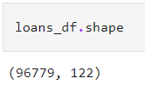
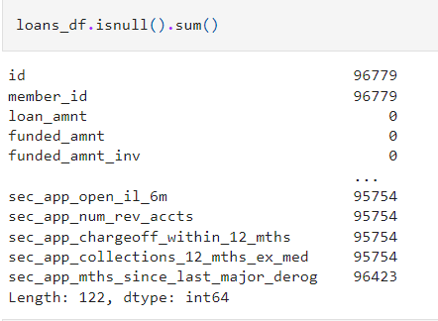
Data Exploration
During the initial data exploration, the following was discovered: The dataset shape was The id and member_id columns did not contain any values. 112 columns had mixed data types. Approximately 20 columns had excessive null values. There were many columns that contained repetitive or unnecessary information. Some column names needed to be changed to more easily represented the data they contained.

Slide 6
Data Cleaning
Actions taken during data cleaning process: The id column was dropped, and values were given to the member_id column with data type “int64”. Drop 20 columns that were not necessary to our story or model or were repetitive. Removed string value “months” from term column leaving only the integer value. Employee title and Employment Length columns had null values filled in with the word “None”. Joint Verification status column had null values filled in with “Not Applicable” for individual applications. Multiple columns with null values showing how many of a particular record the applicant had were filled in with a “0”. Example – Number of Charge-offs, if applicant did not have any, the cell was empty. In these cases, putting a zero would allow us to keep that column as a factor without skewing the result. There were 31 column names changed to be more descriptive of their values.

Slide 7
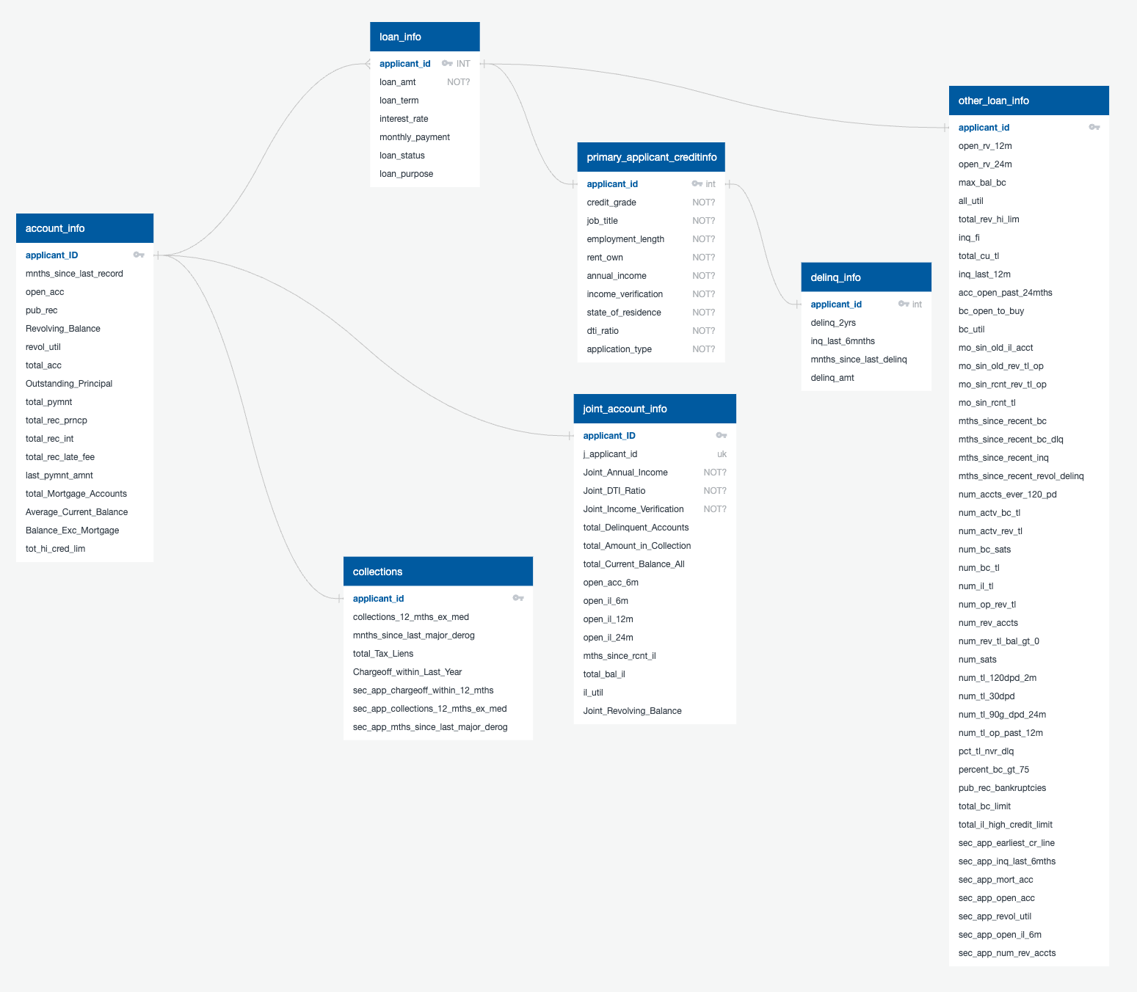
Database
ERD of Tables created in SQL database

Slide 8
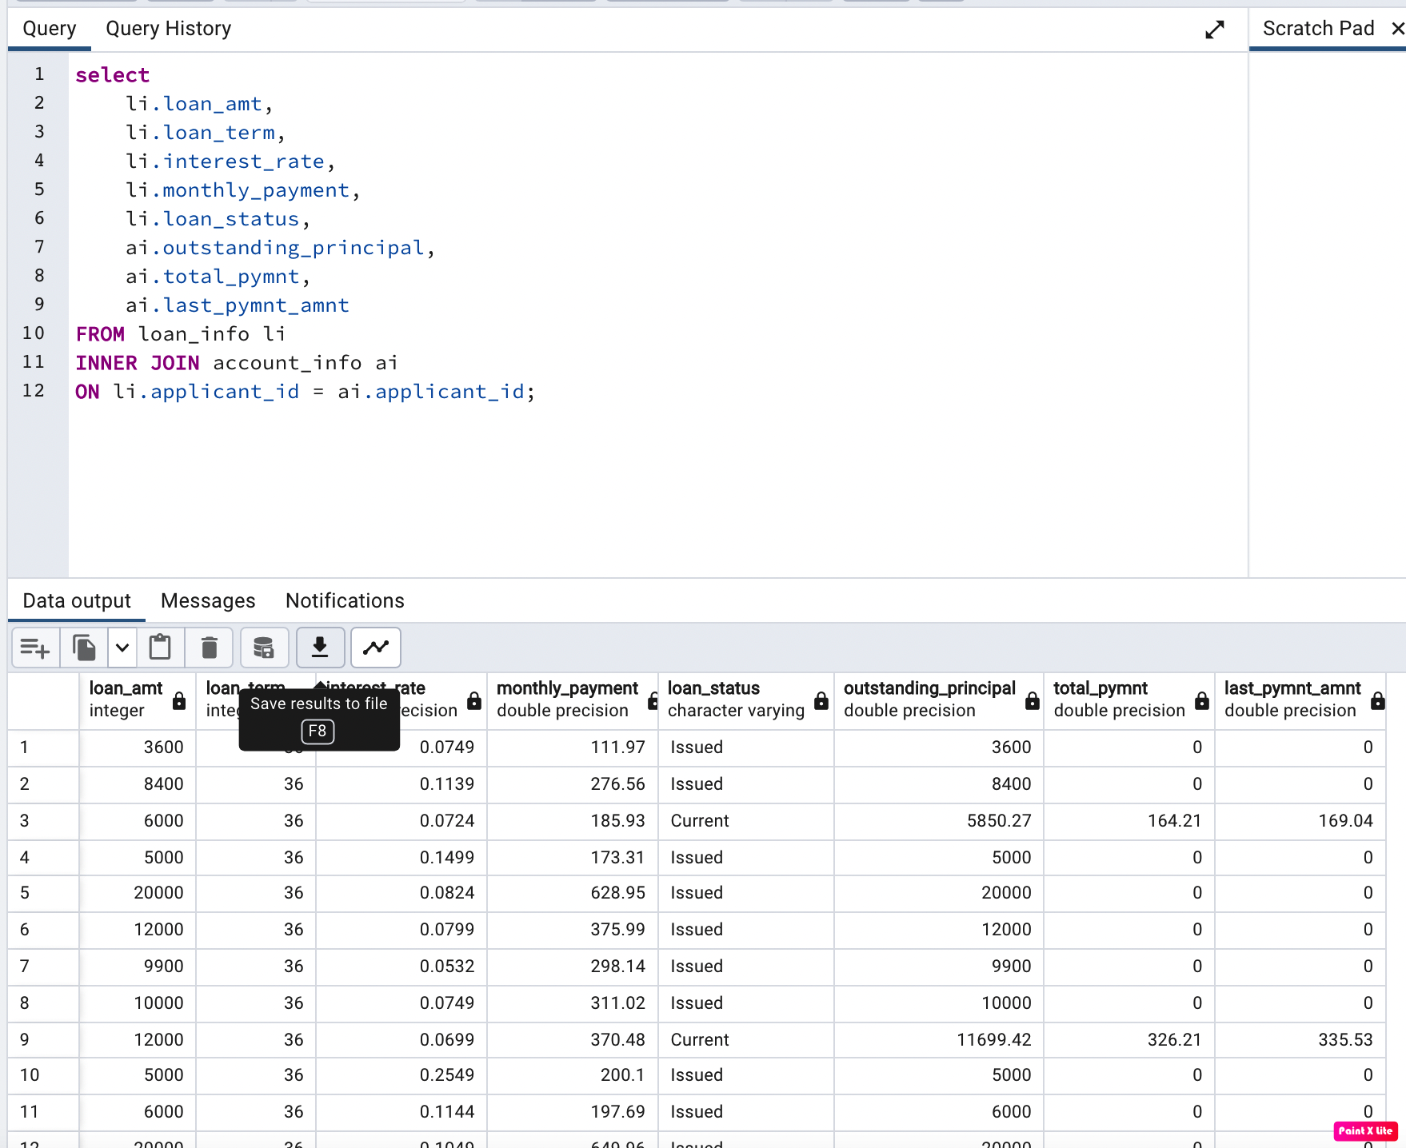
Database – AWS RDS & S3
Created Database & data storage on the cloud (AWS Free tier) Created the RDS – pgAdmin 4 on AWS The Schema file, showcasing the tables & its correlation is uploaded on GitHub The Data file used for training the ML model has been uploaded to S3

Slide 9
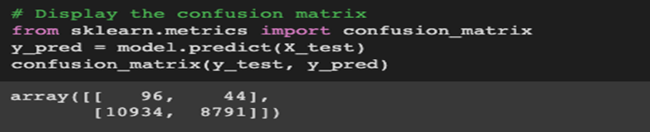
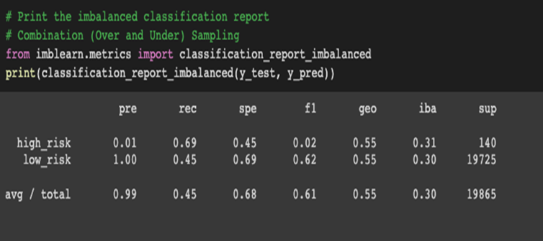
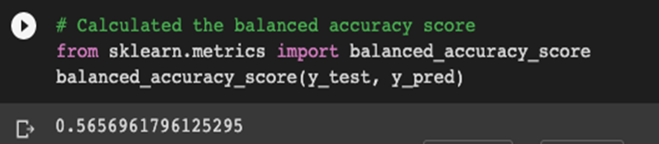
Supervised Machine Learning
Logistic Regression- predicts binary outcomes, meaning that there are only two possible outcomes High risk/Low risk Smote (Over and UnderSampling) Out of 140 good loan applications (Actual 0), 96 were predicted to be good Out of 140 good loan applications (Actual 0), 44 were predicted to be bad Out of 19725 bad loan applications (Actual 1), 10934 were predicted to be bad Out of 19725 bad loan applications (Actual 1), 8791 were predicted to be good Precision-The precision score is low for high risk and high for low risk Recall-The recall high/low risk .01/.99 The calculated balanced accuracy-The calculated balanced accuracy score was 0.56

Slide 10
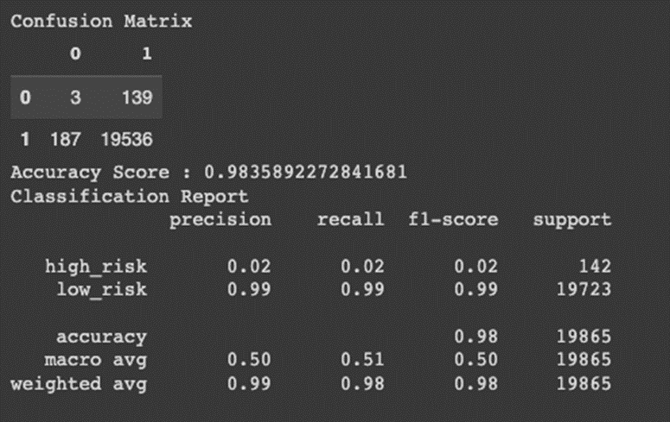
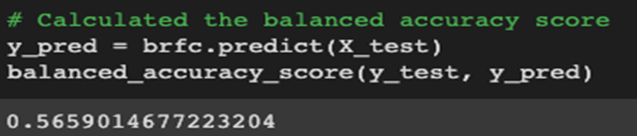
Decision Tree
Decision Tree gave the best result at 98.4% accuracy score. All others were between 50-60% range Confusion Matrix Out of 142 good loan applications (Actual 0), 3 were predicted to be good Out of 142 good loan applications (Actual 0), 139 were predicted to be bad Out of 19723 bad loan applications (Actual 1), 187 were predicted to be bad Out of 19723 bad loan applications (Actual 1), 19536 were predicted to be good Precision-is the measure of how reliable a positive classification is The precision score is low for high risk and high for low risk Recall-is the ability of the classifier to find all the positive samples The recall high/low risk .01/.99

Slide 11
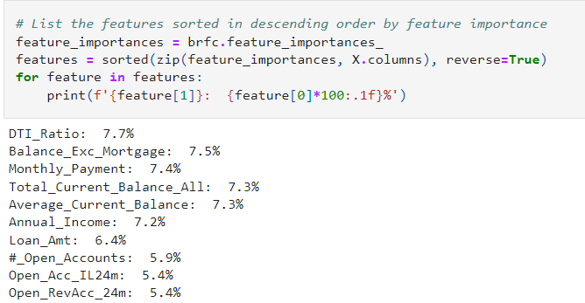
Important Factors
What are the main factors to consider when approving a loan?
The results showed that Debt to Income Ratio was the most important factor in the machine learning model at 7.7%.
The applicants Total Open Balance excluding their mortgage account was 2nd at 7.5%.
Monthly Payment was 7.4%
3 of the Top 5 Factors had to do with the applicants open balance information.
3 of the Top 10 referred to the number of open accounts the applicant had.

Slide 12
Results
What is the most common type of loan taken? Debt Consolidation was the overwhelming leader with 54,811 loans issued. What type of loan is most risky? Medical Loans were most risky according to the percent of loans in “Late” status to total category loans with .74%. Are Joint applicants less likely to default? Joint applicants made up a very small percentage of “Late” status loans and only appeared in 2 categories as being late, Credit Card and Debt Consolidation What is the correlation between Debt to Income Ratio(DTI) and Annual Income? No correlation was found.

Slide 13
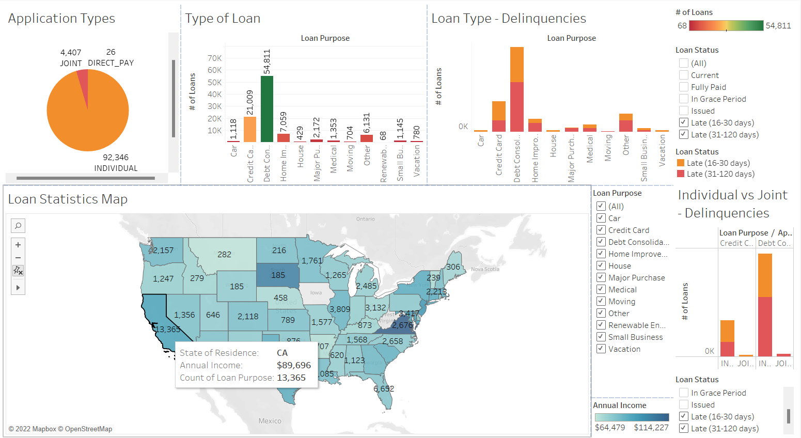
Dashboard Outline - Tableau
Interactive Elements:
Filters on Loan Stats Map and Loan Delinquencies stacked bar
Pop-up markers on Map show additional information

Slide 14
Future Analysis
Future Analysis will include questions which were unable to be addressed within current dataset: The correlation between DTi & Annual Income’s impact on the loan approval amount Ex - consider the below details: DTI = 34.06%, Annual Income = $150,000, Loan Amount = $20000, Tenure = 36 months - Monthly payment = $703.05. Can this new loan request get approved or denied? Determine the Interest Rate % based on the Credit Score Ex - consider the below details: Credit Score = 651, Loan Amount = $20000, Tenure = 36 months What will be the annualized Interest Rate? And the Monthly Amount? Develop a Web Application to run the Machine Learning model User Input fields to feed statistics into the model Generate and display a decision based on input features

